Slide 1
IT DIRECTOR READINESS
Personal Growth Plan
Justin Rivera | Senior IT Systems Administrator
Confidential, personal planning notes - February 2026

Slide 2
THE CASE
Nine years of delivery
Area | Evidence
Tenure | Nine years at Ironclad, promoted twice, straight trajectory
Major program | Led the email migration end to end (Phases 1 and 2 on time)
Security | 2024 segmentation overhaul passed external audit, zero findings
Team | Manages four engineers; Tomas ready for senior scope
Credentials | Security+ and CCNA held; CISSP exam December 2026
IT Director Readiness | Personal Growth Plan

Slide 3
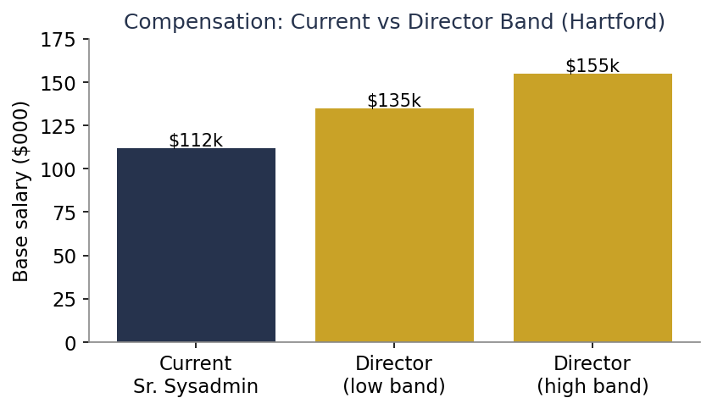
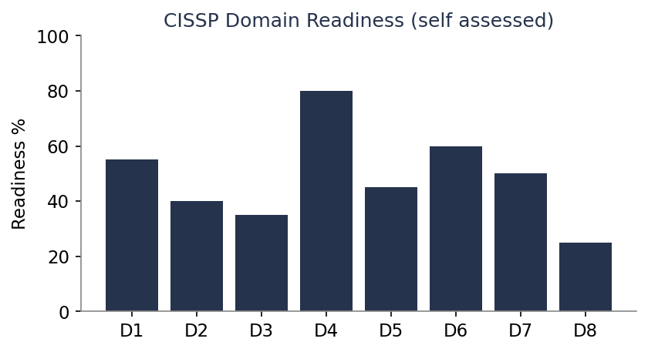
THE OPPORTUNITY
Compensation and readiness
A move into the director band would lift base pay from $112k toward $135k to $155k and reshape the mortgage payoff and 529 plans.
IT Director Readiness | Personal Growth Plan

Slide 4
ROADMAP
Steps before the conversation
• Lock in Phase 3 compliance sign-off or complete the migration.
• Pass the CISSP in December. The cert plus the experience closes the gap.
• Write up the segmentation project as a one-page, results-focused case study.
• Signal readiness to Vanessa informally, without demanding a timeline.
• Align with Patricia on the hours and visibility a director role brings.
IT Director Readiness | Personal Growth Plan

